Slide 1
GETTING SMARTER BY THE DAY:
GLOBAL COMPANIES USED IN AI

Slide 2
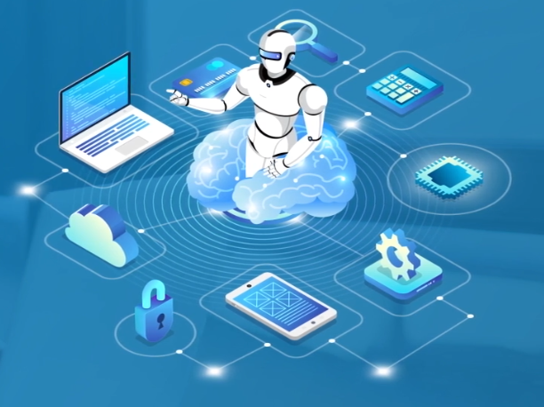
ARTIFICIAL INTELLIGENCE
How AI is Elevating the Performance of Global Companies
ROSE MARY THOMAS
Mtech- S3
Computer Science and Engineering
Baselios Mathew II college of Engineering

Slide 3



C O N C E P T
AI-adoption-across-four-regions-of-the-world
History
AI
13 Facts on How 13 Industries Use AI
Historical Evolution of AI
Global companies
INTRODUCTION
Role of AI in Business
Companies are Adopting AI
What is AI?
Business
Business Benefits and Risks
Applications

Slide 4
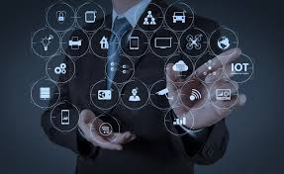
ARTIFICIAL INTELLIGENCE
Computer science the field of AI defines itself as the study of “intelligent agents”.
“Intelligent agents is a system that perceives its environment and takes actions that maximize its chances of success”

Slide 5
Generally, the term “AI” is used when a machine simulate functions that human’s associate with other human minds such as learning and problem solving.
Learn
Recognize
Act

Slide 6
AI PRODUCTS
Cognitive technologies
AlphaGo - IBM
Robotic surgeon - Isaac Asimov, Dr. Gill Pratt
Amazon’s Echo - Amazon
Google’s Home - Google
Self-driving car - Toyota Motor
DeepMind - Google
Oline search engine - Microsoft

Slide 7
Flashback…..,
1923 | - | “Rossum’s University Robots (RUR)” - London - robot”
1945 | - | Isaac Asimov - Columbia University - Robotics.
1950 | - | Turing Test - Alan Turing. Claude Shannon - chess playing
1956 | - | John McCarthy - Artificial Intelligence.
1958 | - | John McCarthy - LISP programming language for AI
1964 | - | Danny Bobrow’s - natural language
1979 | - | Autonomous vehicle - Stanford Cart was built.
1984 | - | Dennett - robots common sense.
1990 | - | Major advances in all area of AI: Significant demonstrations in Machine Learning Case-based reasoning Multi-agent planning Scheduling Data mining, web crawler Natural Language understanding and translation Vision, virtual reality Games
1997 | - | The Deep Blue Chess - Gerry Kasparov
2000 | - | Robot Pets , MIT– Kismet that expresses emotions.

Slide 8
Highlights-of-AI-adoption-across-four-regions-of-the-world
North America and Europe Home to Biggest AI Spenders
Latin America and Asia Pacific companies gained more
835 companies and their AI initiatives and plans
AI is No Longer Sci-fi
4 regions
13 industries
13 business functions
Average revenue
YOUR SUBTITTLE
AI is creating new jobs
AI is fundamentally changing the nature of work

Slide 9
7. Industrial manufacturers view AI as important to competitiveness
1. Improving product and service quality is most important for auto companies
5. Healthcare and life science use AI to improve the business
57% of the AI budget is used to enhance the business rather than transform it
Berg Health uses AI to undertake research on prostate pancreatic cancers
3. CPG companies primarily use AI in sales
13 Facts on How 13 Industries Use AI
51% use the technology in core manufacturing
At Donnelly custom manufacturing’s Minnesota plant, robots remove parts from a conveyor belt and stack them count finished products, and pack products for shipment
More than half the companies use AI this function
Kraft foods app suggests customized recipes to shoppers
58% use AI in the manufacturing function
Toyoto and GM are investing in developing driverless cars
AI’s Footprint is Rapidly Expanding
We surveyed 835 companies from 13 industries across the world
Of these more than 80% already use artificial intelligence
4. Energy is a leading adopter of AI
2. BFS Companies believe AI is Crucial to their Ability to compete
8. Insurance spends the most on AI
6. High Tech companies use AI to detect and prevent attacks
80% use AI in IT
Qualcomm uses AI in its chips for Android smartphones to block malicious software
The average per company spend was $124 million in 2015
AIG invested in startup that is develoing advanced analytics software and wearable to improve employee safety
100% of the companies use the technology
National OilWell Varco has automated the oil extraction process with AI
Building Ai system that cant be hacked is a key success factor for BFS
CircleUp uses the technology to determine which companies to found

Slide 10
10. Retailers say AI will have the Biggest impact on sale
12. Travel, Transport, and Hospitality Aims to help customers get more value from their services with AI
9. Developing a System that makes good and safe decisions is key for media and information companies
31% predict a beneficial ipact in this function by 2020
The north Face uses AI to provide personalized shopping advice
By 2020,TTH will allocate 52% of the cognitive budget to transformational projects
A robot brings items from the lobby desk to travelers rooms at two California aloft hotels
36% use AI in marketing, finance, and strategic planning
Spotify uses deep learning technology to determine which acoustic elements of songs makes them interesting to listeners
11. Telecom Generates the most value from AI
13. Utilities Spends Higher than 11 others industries on AI
These companies had 20% cost reductions and 25% revenue increase in areas in which they used AI
Telefonicas multi-sensory geolocation solution provides user with the most accurate indoor location
0.53% of their annual company revenue was dedicated for AI initiatives
Enel SpA uses machine learning to pinpoint fault in its grid

Slide 11
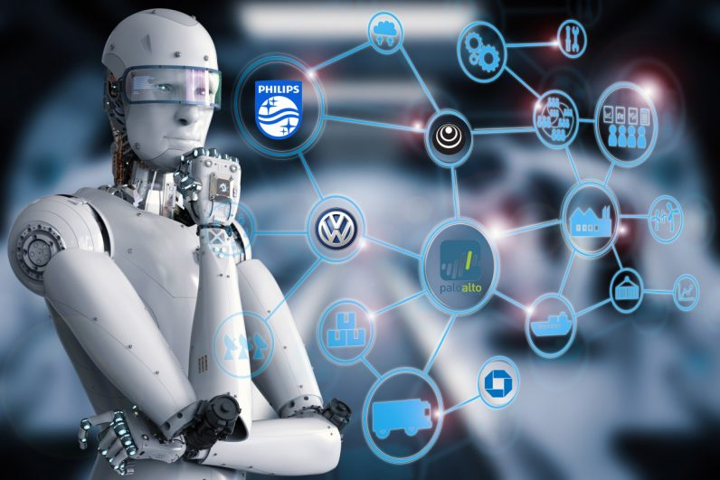
How Leading Companies are Adopting Artificial Intelligence

Slide 12

Who are the leaders in AI adoption?
The Leaders
The followers
Leaders View AI more strategically
1.5 leaders consider cognitive technologies vital to their competitiveness
Leaders use AI at the highest levels of the company

Slide 13

Leaders Deploy AI beyond IT
Leaders use AI in HR, finance, distribution and other functions
4X leaders use AI in finance to determine economic trends
2X leaders use AI in finance to identify and advise on customer payment problems
Leaders invest much more in AI than Followers
Leaders likely to spend 5X as much on AI in 2020

Slide 14

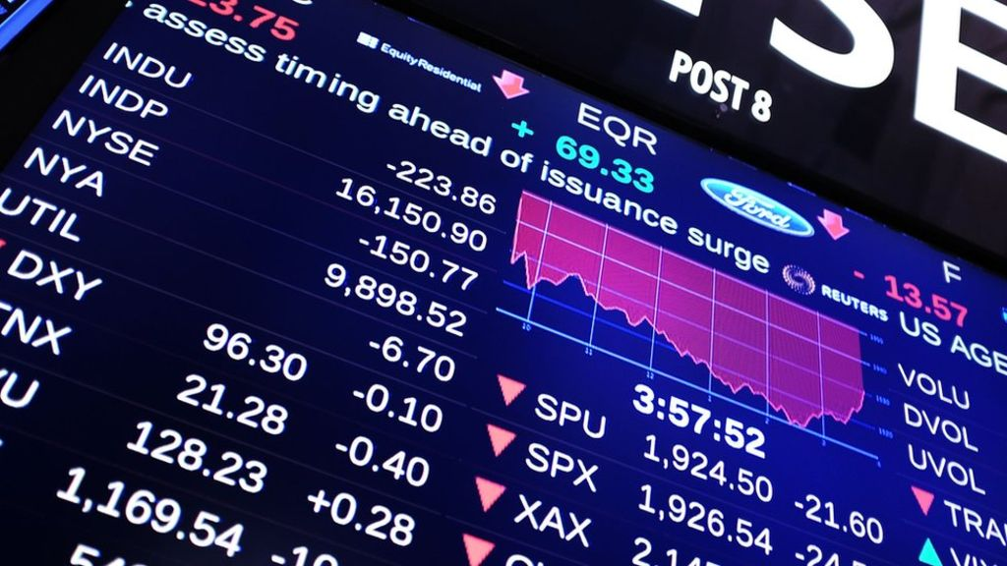
:Winning Customers with Machine Learning
Better Products, Higher Market Share
Investing self- learning algorithm.
“The quality of Bing’s ranking results depends entirely on the machine learning models behind it.”

Slide 15

Using AI to improve business processes
Big Data for Big Results
Nothing Artificial about Great Customer Service

Slide 16
Measuring the Impact of AI
8
Key Findings
Average AI investments per company are highest North America and Europe
84% companies think AI is essential, and nearly half see it as transformative
2
4
Only a few are making bold investments today, which may trigger a competitive imbalance tomorrow
AI’s impact goes far beyond the IT function
1
3

Slide 17
Five key characteristics define companies with the biggest AI gains
AI is predicted to both automate and create new jobs
5
7
8
6
Four factors are most important in determining whether companies benefit from AI
AI is helping employees do better work, and companies do work they couldn’t do before

Slide 18
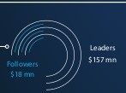
Five key characteristics
Make far bigger AI investments to remain competitive
1
Average
2019
Spend per company
2
Use AI across organizational functions
Followers | Leaders
Corporate Center
Distribution and Logistics
Human Resources
Finance And Accounting
12% >>>>>>>>>>>>>>>>>>>>>>>>>>>>>>>>>>>>>>> 31%
6%>>>>>>>>>>>>>>>>>>>>>>>>>20%
12%>>>>>>>>>>>>>>>>>>>>>>>>>>>>>20%
22%>>>>>>>>>>>>>>>>>>>>>>>>>>>>>>>>>>>>>>>>>>>>>>>>>>>35%

Slide 19
3
Implement AI in areas that directly affect the topline
60%
69%
67%
83%
83%
Of those using AI in finance and accounting use it for customer credit checks
Of those using AI at corporate level use it to address potential customer payment problems
Of those using AI in IT use it to ward off hackers
Of those using AI in R&D use it to create smear products
Using AI in the marketing use it to improve media buying
Ensure IT does not suffer from the cobblers children's syndrome
4
5
Address fears of job losses

Slide 20
Measuring the Impact of AI
How 13 global industries use
Artificial Intelligence
8
Key Findings
More than 90% of companies in five industries- Energy, High tech, Telecom, Retail, and Automotive
The most important goal for AI initiatives across industries is improving product and service quality
2
4
Beyond the IT functions, AI is most often used in customer service, sales, marketing, and finance
AI’s greatest impact varies by industry, reflecting the technology’s wide applicability and immense potential
1
3

Slide 21
No.1 success factor is building AI systems that cant be hacked
Telecom companies generated the most value from AI in2019 in terms of cost reduction
5
7
8
Insurance, Consumer Packaged Goods, and High Tech outspend other industries
6
Industrial Manufacturing, High Tech, and Travel, Transportation, and Hospitality

Slide 22

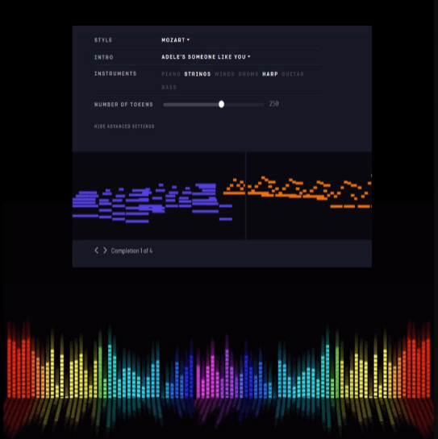
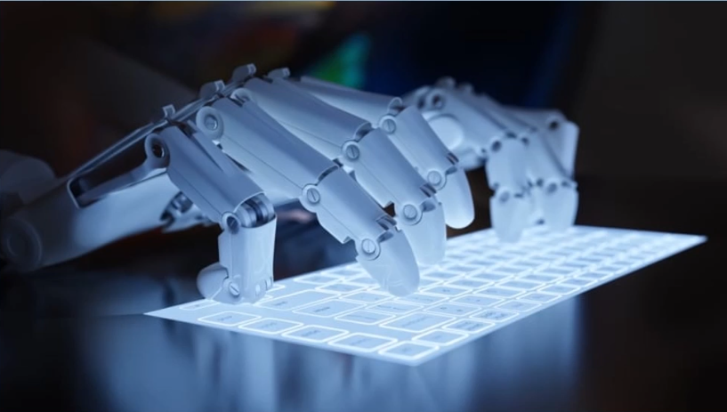
10. AI IN ARTIFICIAL CREATIVITY
MuseNet
MuseNet, a deep neural network that can generate 4- minute musical compositions with 10 different instruments.
Wordsmith
Wordsmith is an AI- powered tool that produces written analytics by transforming the given data.

Slide 23
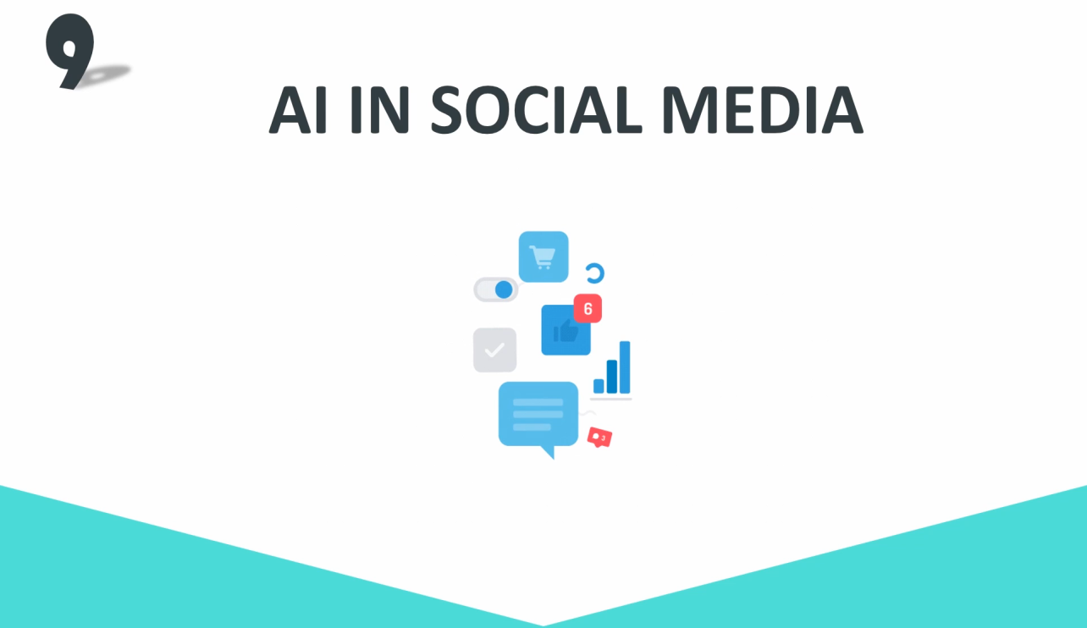
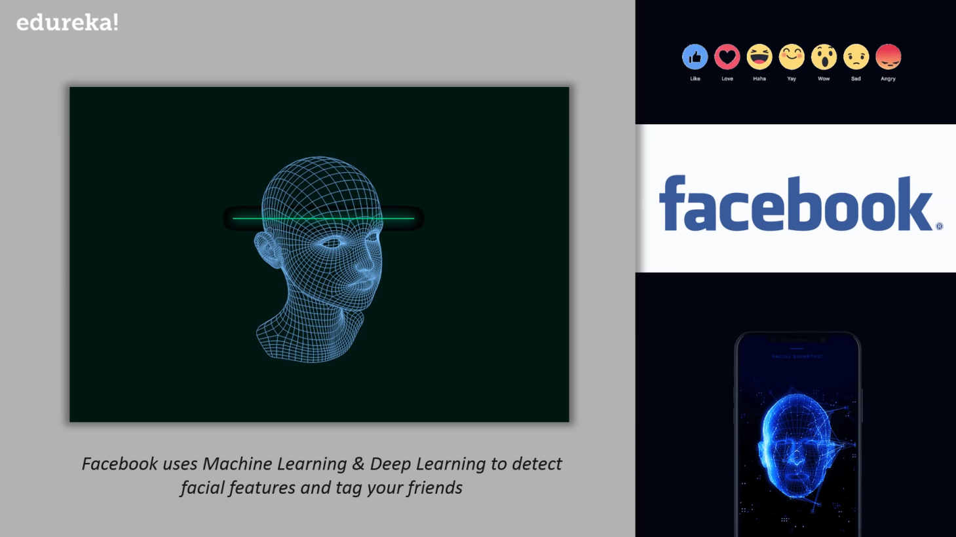
9. AI IN SOCIAL MEDIA
Facebook
Facial features, Machine Learning & Deep Learning to detect facial features and tag your friends
Twitter
Twitter’s is using AI to identify hate speech and terroristic language in tweets
The company discovered and banned 300000 terrorist- linked accounts, 95% of which were found by non-human , artificial intelligent machines.

Slide 24
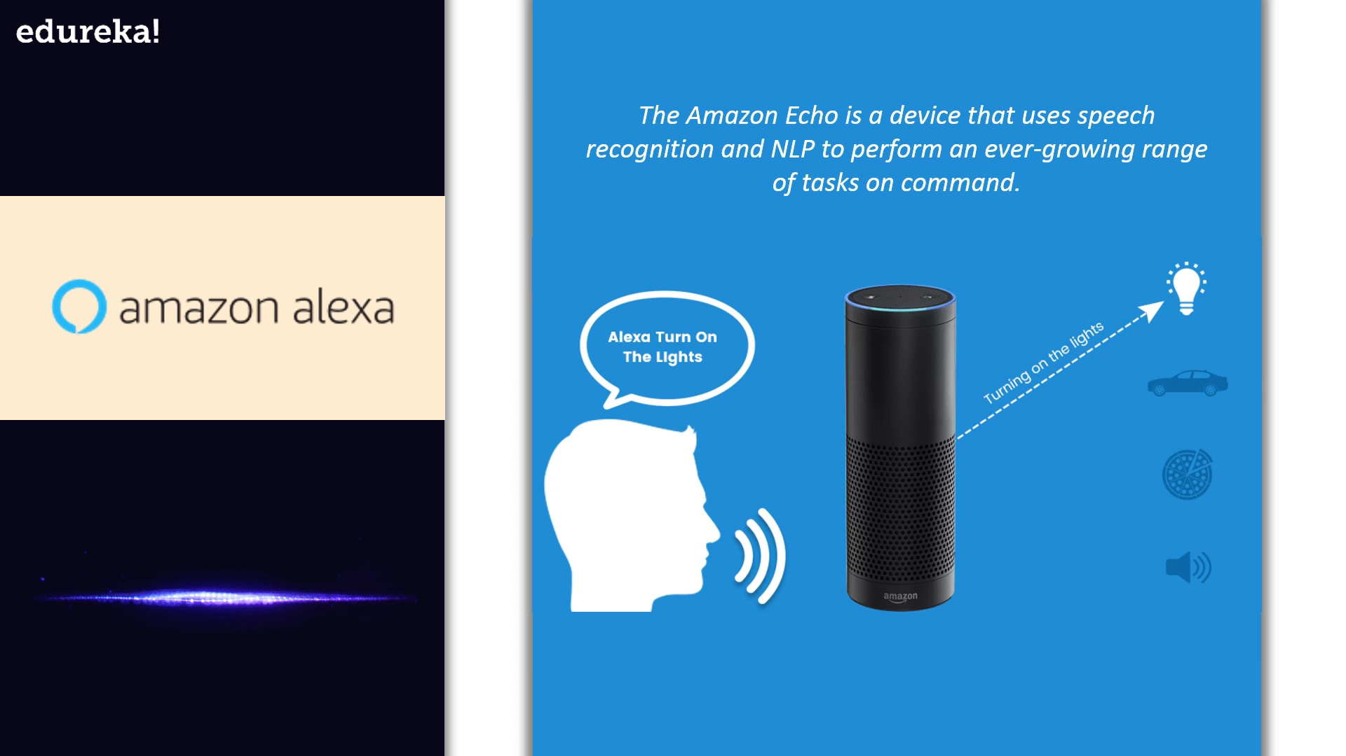
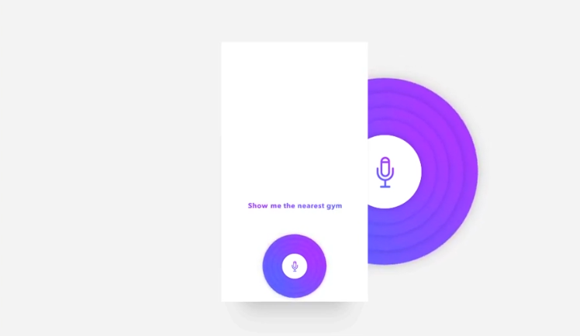
8. AI IN CHATBOTS
Google Assistant
Amazon Alexa
Google Assistant is designed to have conversations with you in order to complete tasks. It uses AI to process natural language and perform tasks like book appointments and make calls.
The Amazon Echo is a device that uses speech recognition and NLP to perform an ever- growing range of tasks on command

Slide 25
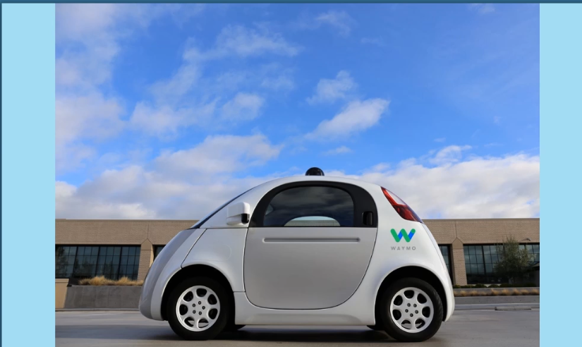
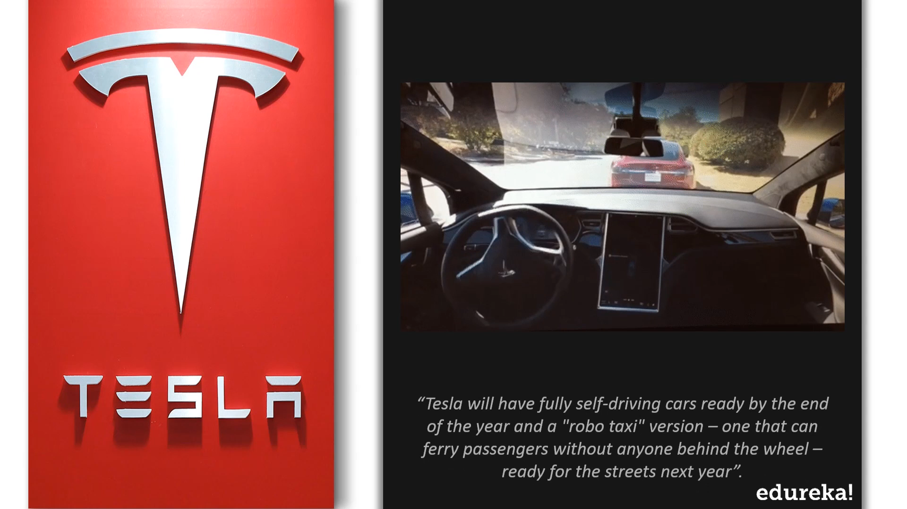
7. AI IN AUTONOMOUS VEHICLES
Waymo
Waymos AI software crunches data from the vehicles’ lidar to produce control signals that operate the driverless vehicle
Tesla
Tesla will have fully self-driving cars ready by the end of the year and a “robo taxi” version – one that can ferry pasengers without anyone behind the wheel ready for the streets next year

Slide 26
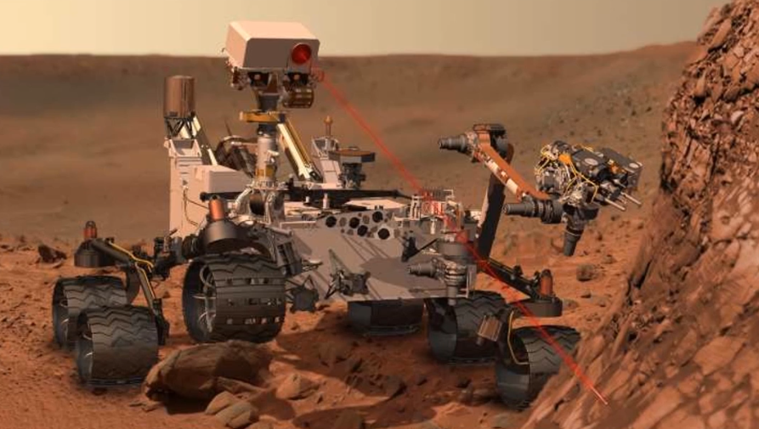

6. AI IN SPACE EXPLORATION
The known AI AEGIS is on the red planet onboard NASA’s current rovers. It is developed to handle autonomous targeting of cameras and choose what to investigate
Astronomers Used I To Sift Through Years Of Data Obtained By The Kepler Telescope To Identify A Distant Eight Planet Solar System

Slide 27

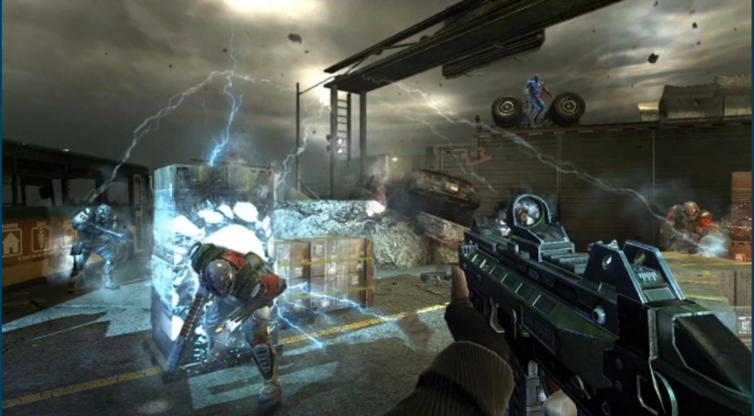
5. AI IN GAMING
AlphaGo
F.E.A.R

Slide 28
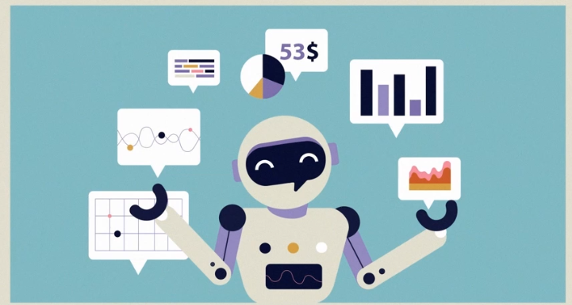



4. AI IN BANKING AND FINANCE

Slide 29
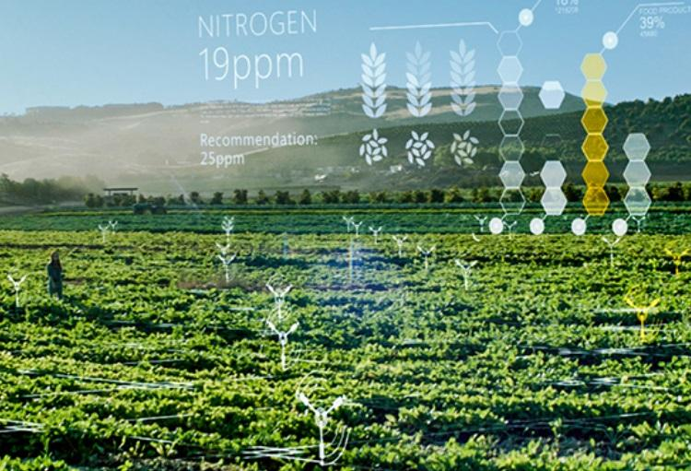
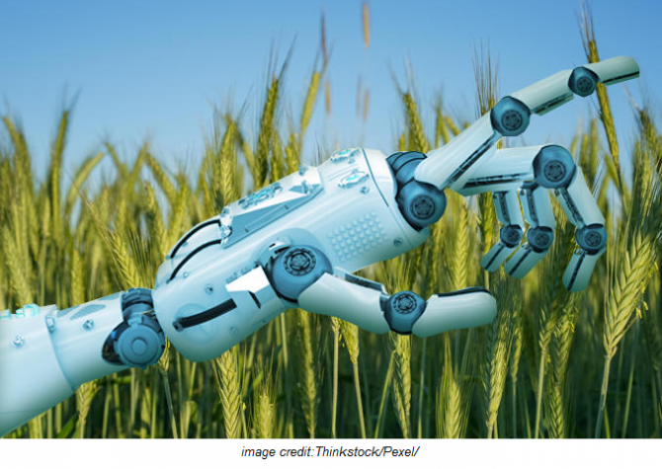
3. AI IN AGRICULTURE
Pantix
Blue river

Slide 30



2. AI IN HEALTHCARE
IBM Watson
DeepMind

Slide 31
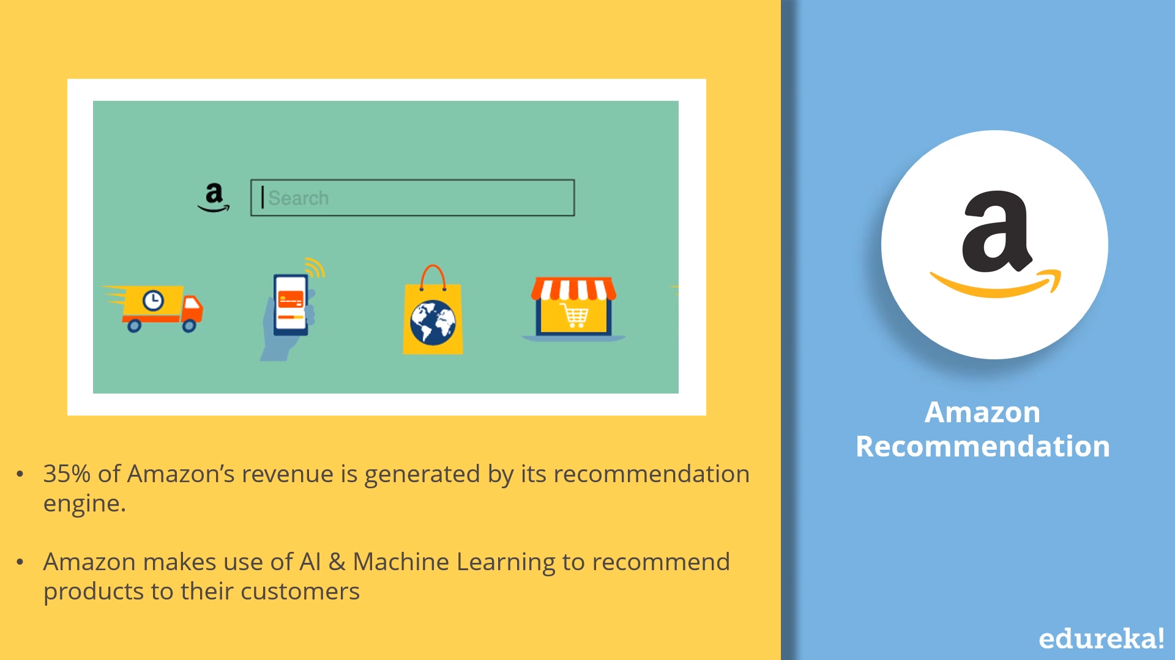
1. AI IN MARKETING
Amazon
NETFLIX

Slide 32
T H A N K YOU

